Slide 1
SAS Introduction

Slide 2
The Language
Just think programing as a kind of language that a machine can understand.
You talk in the same language, so you can tell the machine what to do.
Language has rules. Same with SAS.
The most important rule for is
EVERY SAS STATEMENT ENDS WITH A SEMICOLON
Basically SAS will listen to what you tell it to do until it sees a semicolon, and then do it.

Slide 3

A good program is a green program
SAS is much more flexible than a lot other languages. As a result, it is possible to write a piece that is very difficult to understand.
Commenting is very very very very very very very important. You cannot comment more.
How to comment in SAS?
/* */ or
* ;
Let’s write our first comment!
https://welcome.oda.sas.com/

Slide 4
Small Steps Forward
I have to say a machine is powerful but not very smart.
Think about which one of the following is easier for a 5-year-old to understand:
Build a pyramid with these 15 cubic blocks.
Lay 5 blocks right next to each other in a straight line; Lay 4 blocks on top of the 5 you have laid down; Lay 3 blocks on top of the 4 you have laid down; Lay 2 blocks on top of the 3 you have laid down; Lay 1 blocks on top of the 2 you have laid down; You have a pyramid.
Writing programs should be done in small steps.

Slide 5
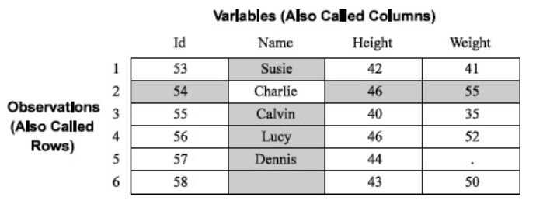
SAS Data Sets
SAS needs data to perform the actions it is capable of.
Here is an example:
Let’s put this data in our SAS Studio!

Slide 6
SAS Data Sets
Copy and paste the following code in your SAS Studio.
DATA Height_and_Weight;
INPUT ID Name $ Height Weight;
DATALINES;
53 Susie 42 41
54 Charlie 46 55
55 Calvin 40 35
56 Lucy 46 52
;
RUN;

Slide 7
Look at the Log
When a program is executed, a log is generated in the log window. ALWAYS read log! It contains useful information.
There are three types of log messages, colored blue, green and red.
NOTE: blue, general (good) information, useful, number of obs.
WARNING: green, not an error but SAS informs you that you may have a problem, although it does not stop processing, still creates a data set
ERROR: red, an error in the code, SAS cannot process the data step, it stops! If you are running the data step to replace an older version of a data set, it has NOT been replaced!
SAS will stop at ERROR. This is pretty important. This means only the steps before the error are executed.
When there is not an error, there can still be mistakes in the code. As a result, we have to check the output.

Slide 8
Data Types
Each column should have one data type.
Numeric or Character
The name should be good enough to explain themselves.
Why the difference?
You have to perform different operations.
For example, you can add two numeric columns together but you cannot
Let’s check the datatypes!

Slide 9
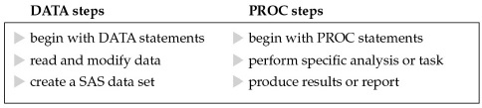
DATA and PROC
SAS programs are constructed from two basic building blocks: DATA steps and PROC steps.
A typical program starts with a DATA step to create or modify a SAS data set and then passes the data to a PROC step for processing.
In other words,
Data steps are used for actions on rows (eg. create a new variable from another variable).
Data steps are usually executed row-by-row.
Proc steps are used for actions on columns (eg. calculate a mean of a variable)

Slide 10
DATA and PROC
Let’s do this:
Create a SAS dataset using the previously loaded dataset and name the new data “BMI”.
Create a new column in the data called BMI. Name the column BMI and BMI is calculated as weight divided the square of height.
Print the results.
When you are done
Congratulations, you have created your first SAS program!
Think about it. What did you do? What does the program do for us?
We created and modified data using DATA step.
We print the data using PROC step.

Slide 11
Data Libraries
SAS data sets are stored and accessed via SAS data libraries.
There is a WORK library by default created and refreshed every time SAS is initiated.
So the data here will be temporary.
You can define other libraries using the LIBNAME statement.
So the data here will be permanent.

Slide 12
Data Libraries
You can create data in a library using the DATA step.
When loading data from a library, you need to use the dot “.”.
Let’s do this:
On SAS Studio, create a folder called “Class_Output”.
Click on “Server Files and Folders”
-> Right click on “Files (Home)”
-> Hover over “New” and click on “Folder”
-> Enter “Class_Output” in the box after Name.
-> Click “Save”.
Create a library called “Class_Export” that’s linked to the “Class_Export” folder we just created.
We have to know the path to the folder in this one.
Create a copy of the BMI data in this folder.

